Slide 1
Depot Systems 5
Windows Tablet App Gate Overview

Slide 2
Windows Tablet App Add-On
Supports Full Gate In, Gate Out, Status Change, and Yard Check
Full Estimate writer and ability to write estimates on Gate In screen
Uses any Windows 10 tablet
Supports Bluetooth hip printers and or full laser prints.
Saves all data in real time to server

Slide 3
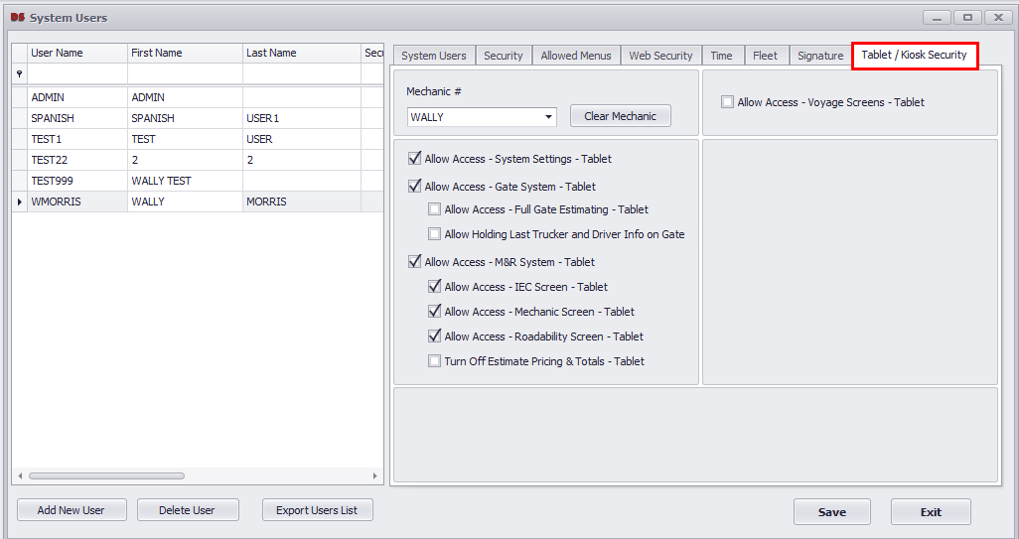
Tablet Security
All tablet app software controls are set within the DS5 PC system. Each user has their own settings as shown below.

Slide 4
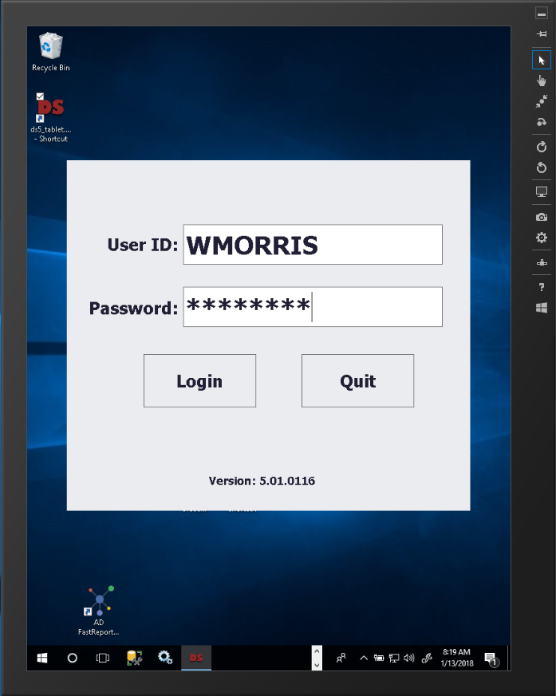
Login
Each user requires a login, once the user logs in, all accounts, trucker codes, damage codes, etc. will download to the tablet.

Slide 5
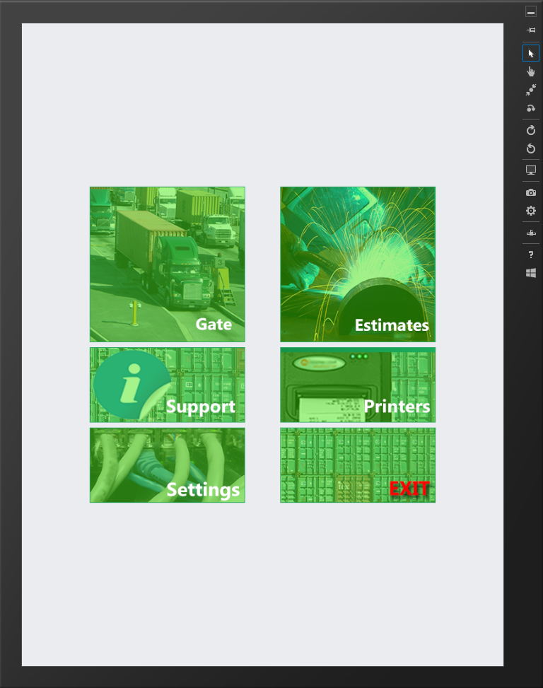
Main Menu
From the main menu you can access the gate or estimate parts of the system. Printers can be setup from the printers menu. Security settings will apply to each user login.

Slide 6
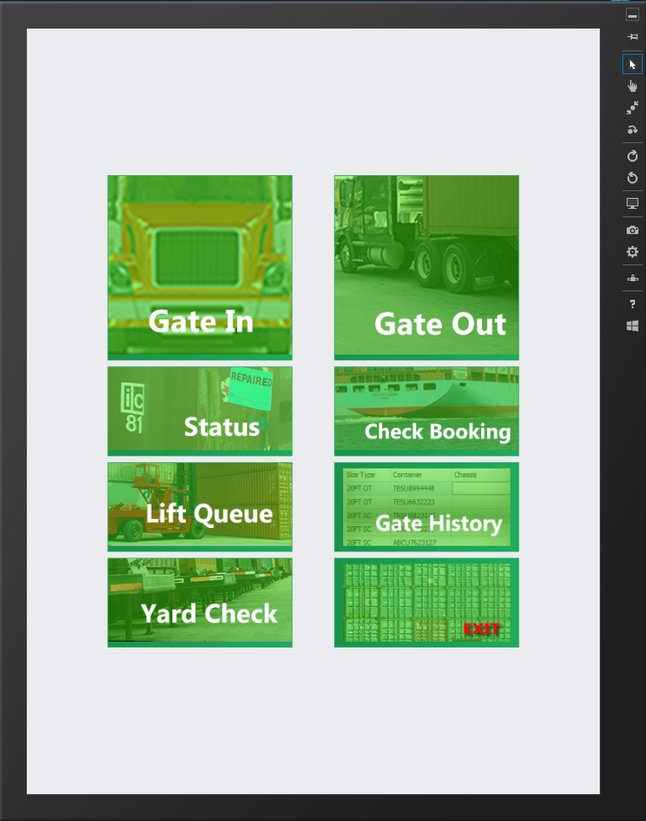
Gate Menu
Gate Menu contains all gate functions, Gate In, Gate Out, Status Change, and more as shown.

Slide 7
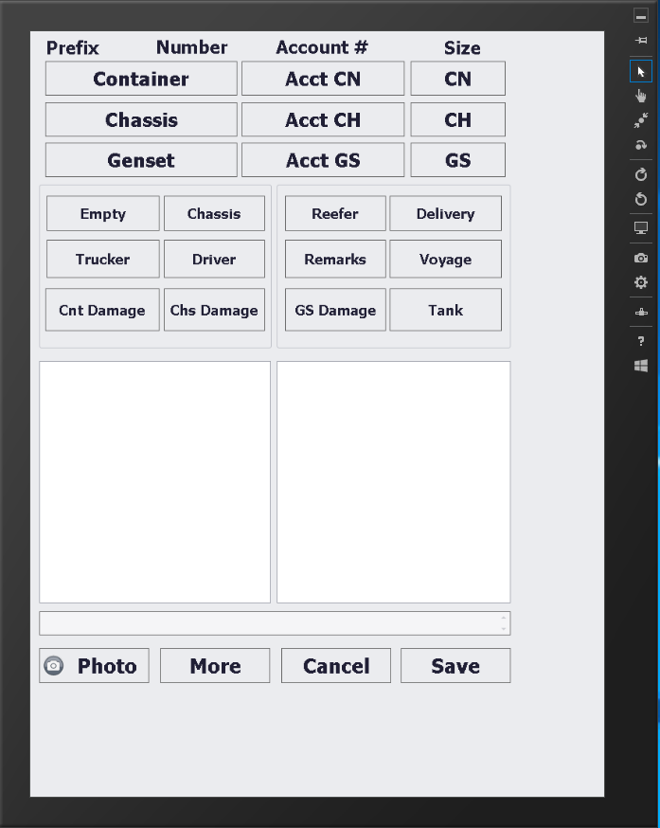
Gate In Screen
Gate In can handle any equipment type and has additional screens to handle damages, reefer units, tank containers, re-delivery numbers, and all chassis items.

Slide 8
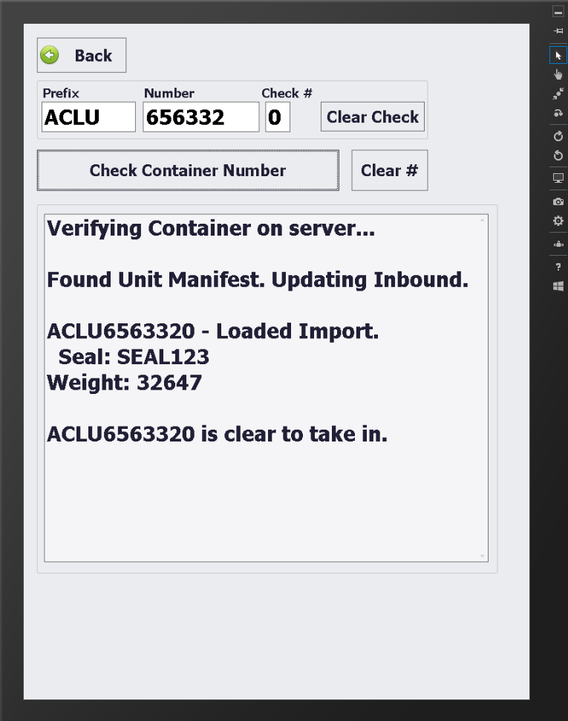
Gate In Equipment
As you enter in the equipment, the system will verify unit and can do full fleet file checking. If the unit has a manifest or re-delivery number the information will appear and pull into the gate in.

Slide 9
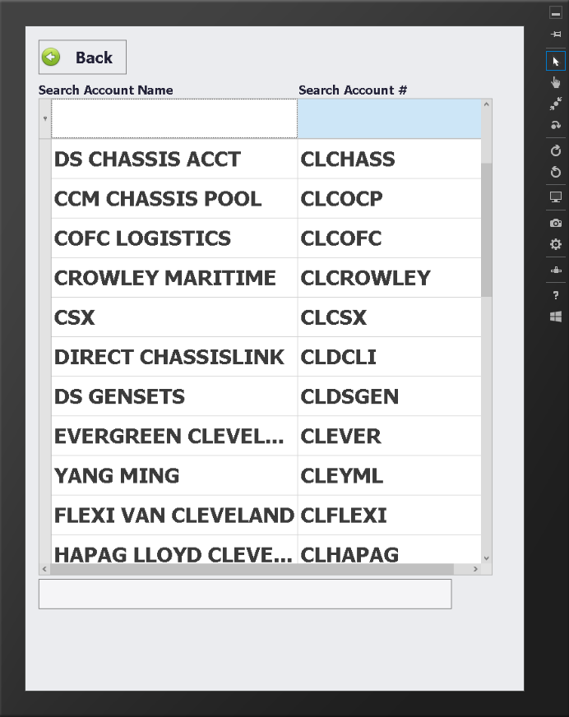
Gate In
All screens are built for 8 to 10 inch screen sizes. They are easy to use and easy to see, Each screen is built to be easy for use with your finger in an outdoor environment.. Use the filter row at the top to enter in filter values on larger lists.
Each screen will use the on screen keyboard as needed.

Slide 10
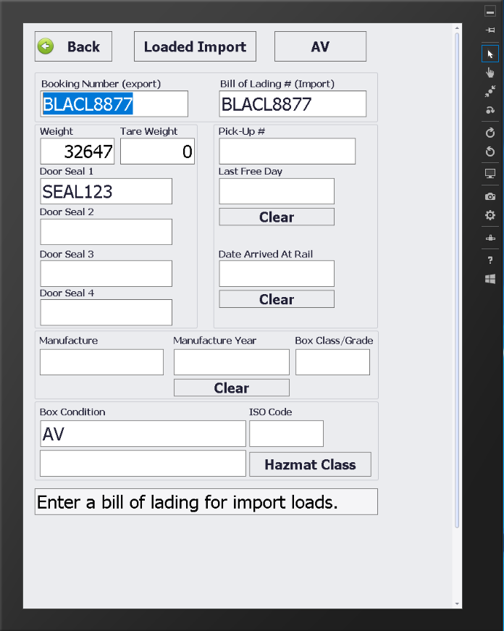
Gate In Container
The container button has the booking, Bill of Lading, load, and other container information.

Slide 11
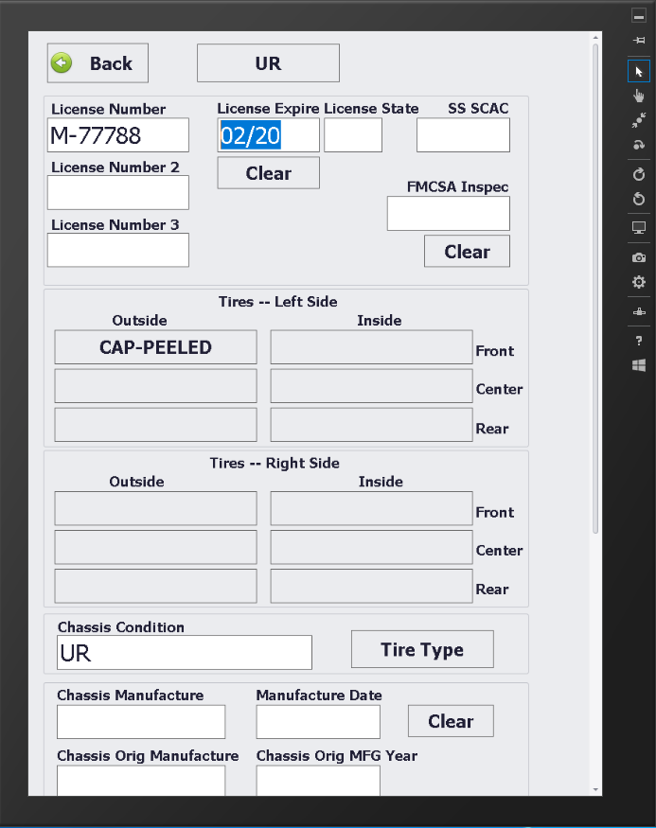
Gate In Chassis
The Chassis button has all needed chassis information, license, FMCSA and tires.

Slide 12
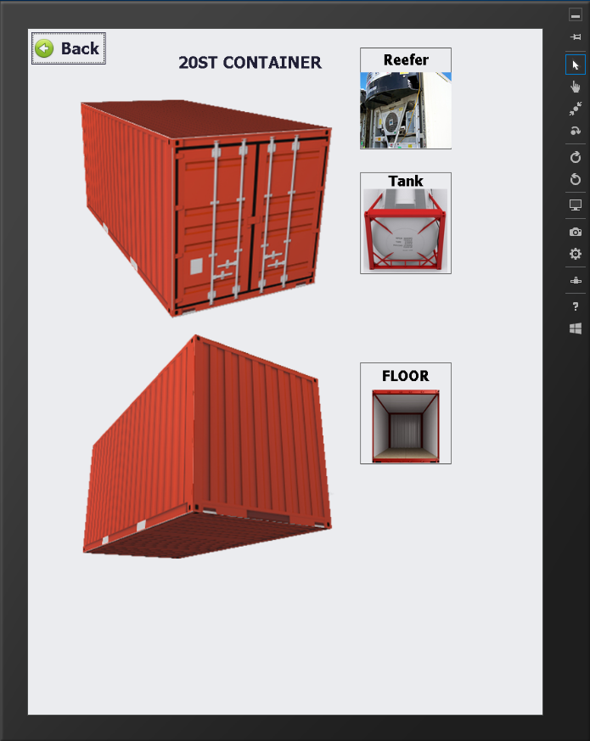
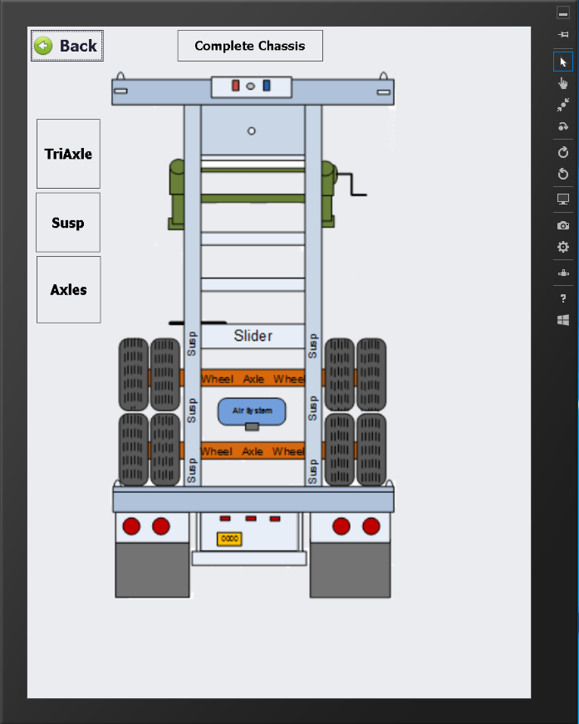
Gate In Damages
The container or chassis damage buttons will display a screen image to select the location of the damages

Slide 13
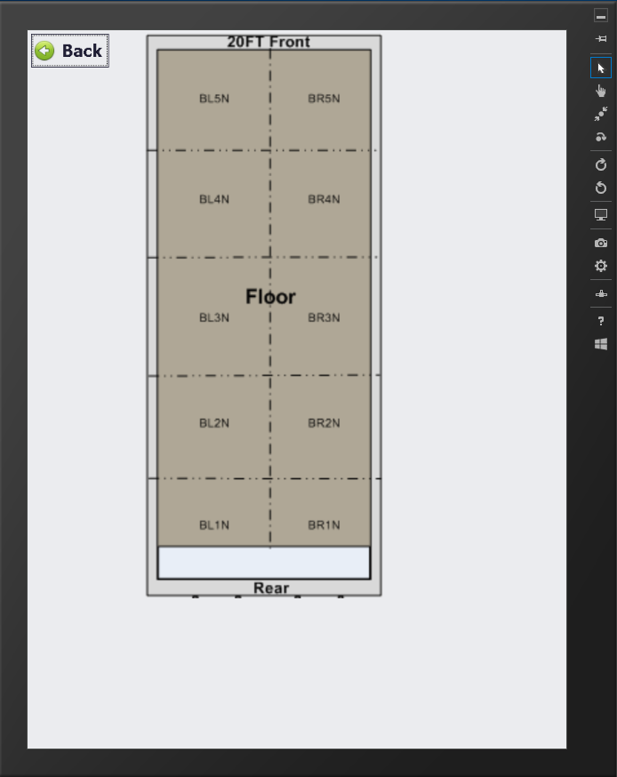
Gate In Damages
For containers, you can then select the area of the damage to get a location code.

Slide 14
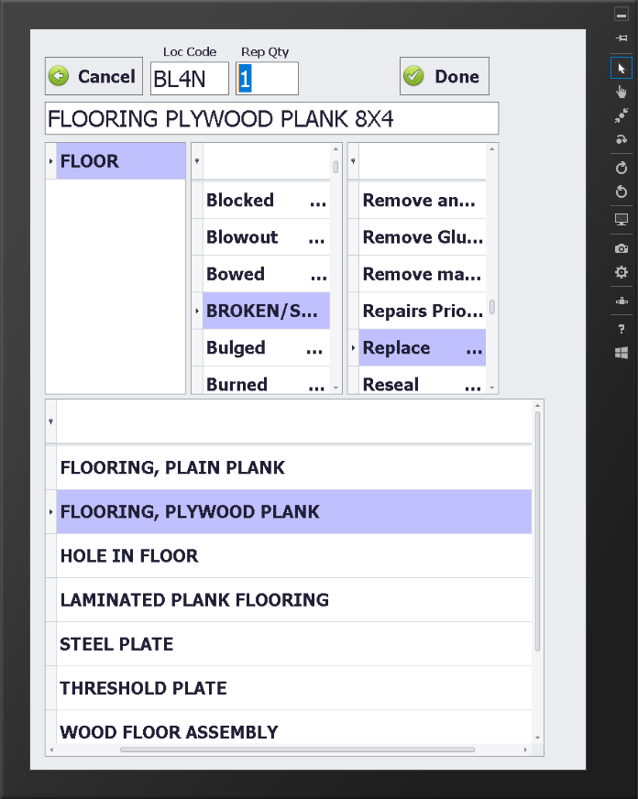
Gate In Damages
Then select the damage and repair information. This information can be used to create estimates in the system as needed.
These damages will also print out on the interchange.

Slide 15
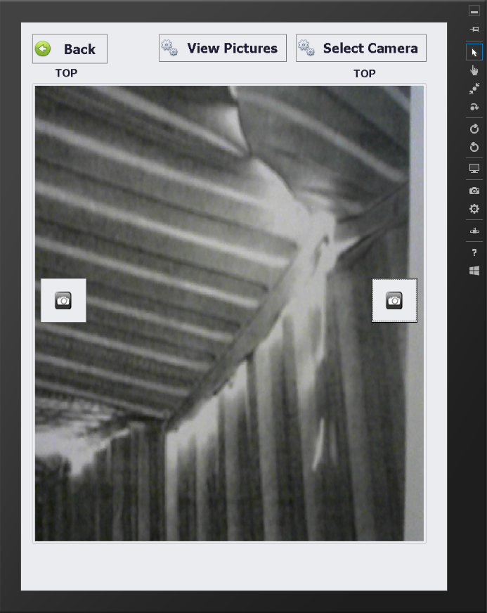
Gate In Pictures
Click the Photo button to take pictures as needed. There is no limit to the amount of pictures taken. All pictures will auto save back in to the system and will be connected to the gate in.
Each picture will have the unit number and date / time imbedded into the bottom of the picture when saved.

Slide 16
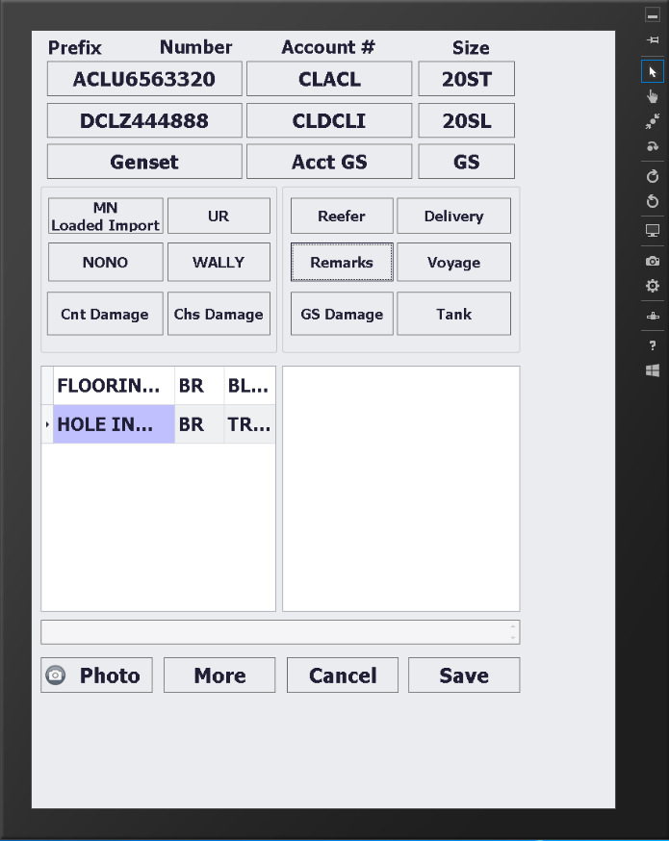
Gate In
Once you have all the information needed click save to have the driver sign and gate in the unit.

Slide 17
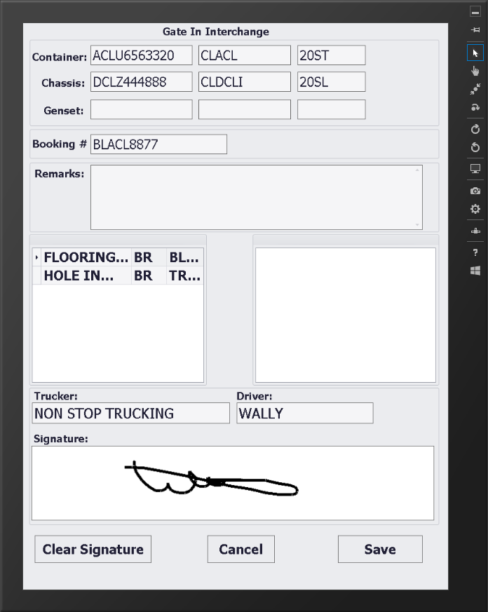
Gate In Save
You can get a driver signature on the screen. This signature will print on the interchange and save back into the system with the gate in.

Slide 18
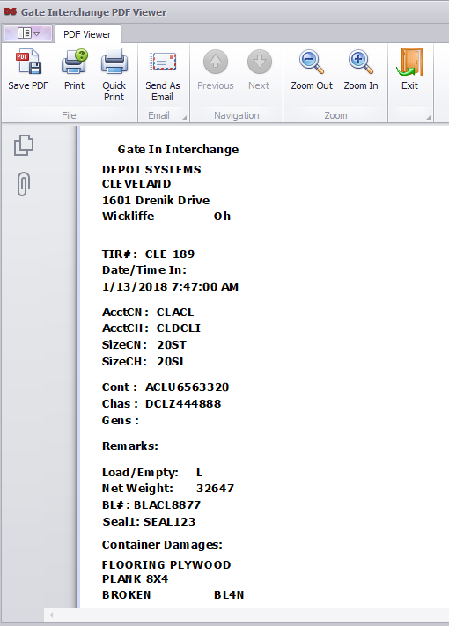
Gate In Interchange
The gate in will print a Bluetooth or full laser print per the account settings.
Sample Bluetooth hip printer print out.
All interchanges will save into the system and can be reprinted or emailed at any time.

Slide 19
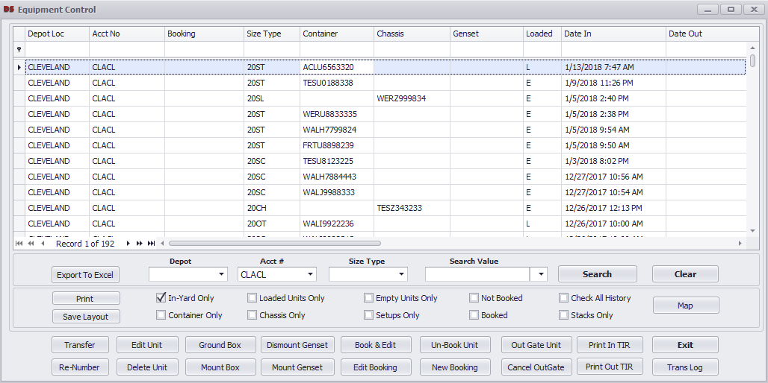
Gate In Save
Each gate in will save real time back to the main system. The gate will be instantly accessible in the system and EDI will send out in 5-10 minutes.

Slide 20
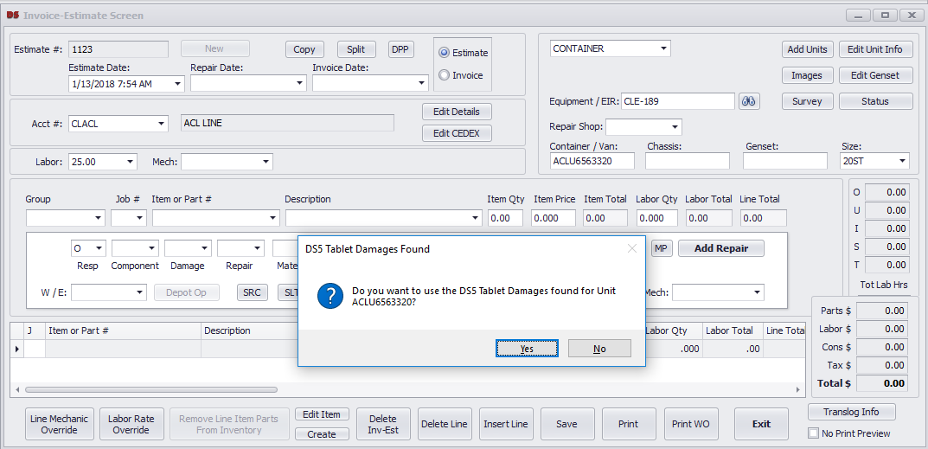
Gate In Damage Estimates
Each gate in will save any damages to the gate in and can create estimates. There are a number of control switches that can be set to auto or manual create estimates. Below shows the estimate asking to pull in damages from the gate in.

Slide 21
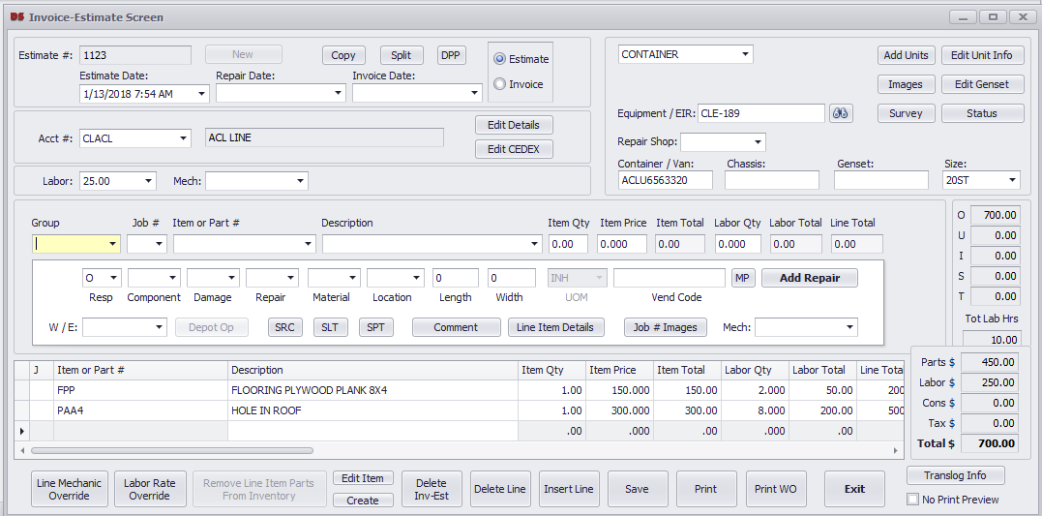
Gate In Estimate
Below shows the damages that were pulled in from the gate in damages pick list. The estimate will also contain any pictures from the gate in.

Slide 22
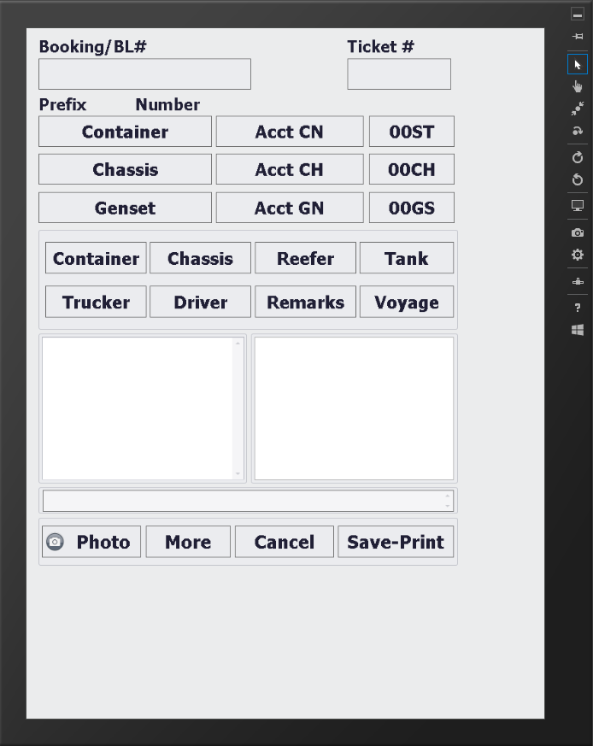
Gate Out
Full gate out control is supported on the tablet system. All safety controls found in the PC gate out screen work the same from the tablet gate out.
Auto equipment mounting of container, chassis, and gensets is performed on the screen.

Slide 23
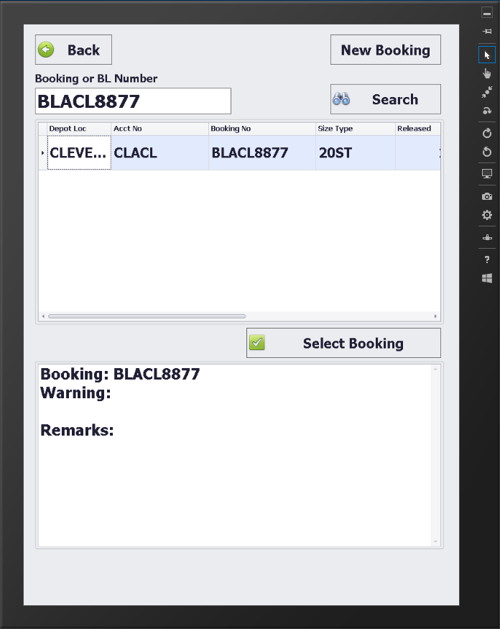
Gate Out Booking
Users can search bookings on the tablet screen and get all booking remarks or warning messages for the booking.

Slide 24
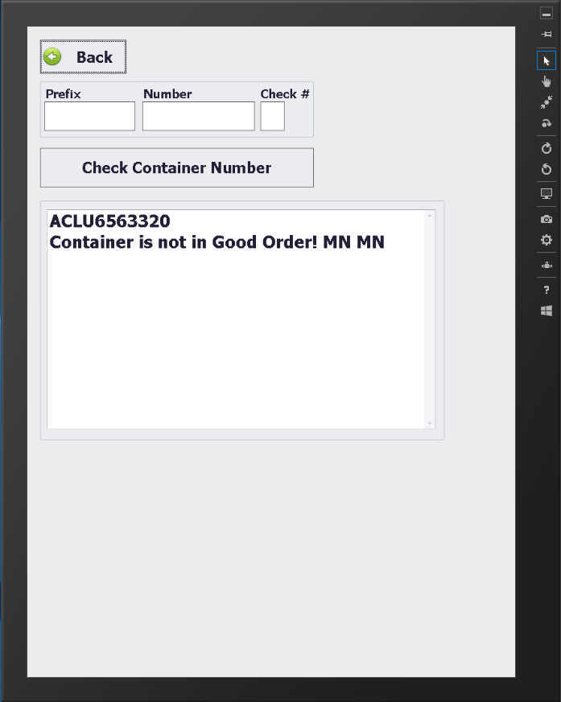
Gate Out Equipment
Equipment checking is performed to verify equipment, status, and other settings before allowing the equipment to gate out.

Slide 25
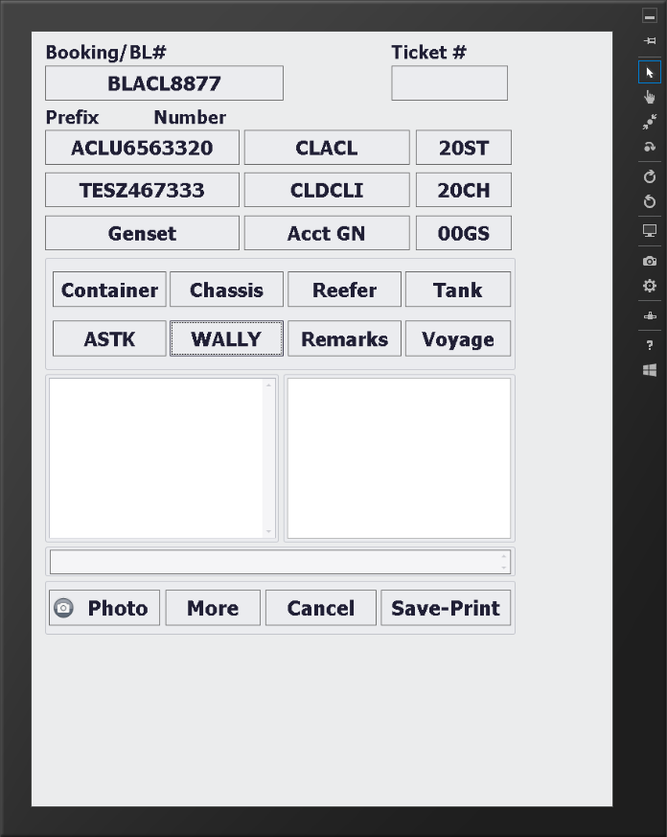
Gate Out
Once all information is entered and cleared, the gate out can be saved.

Slide 26
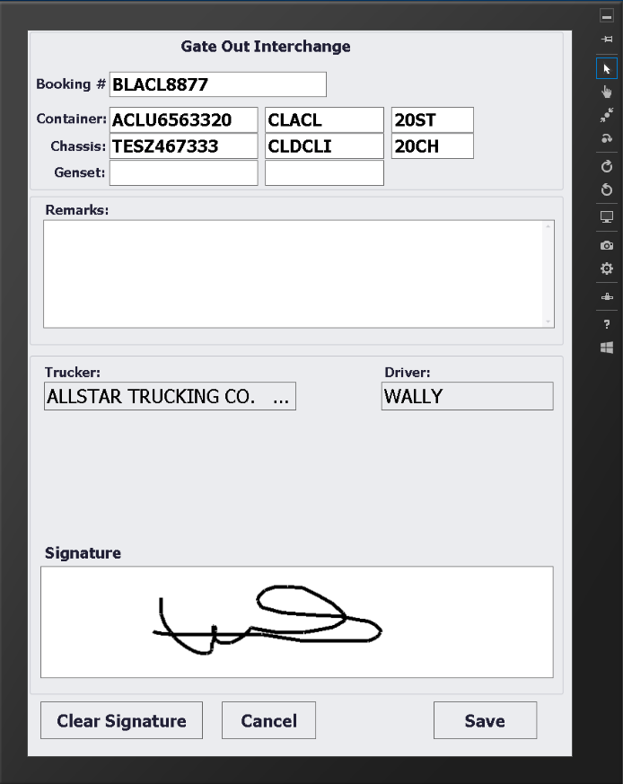
Gate Out Save
Gate will then get a drivers signature to complete the process.

Slide 27
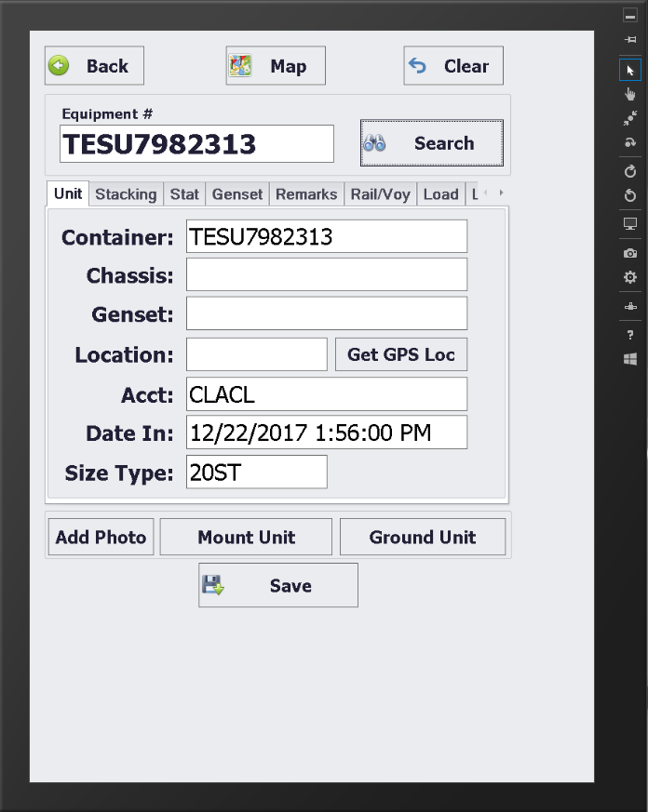
Status Screen
The Status screen will allow updating units in yard. You can change the status, location, and other values. You can also mount and ground containers from here and add chassis to stack numbers.

Slide 28
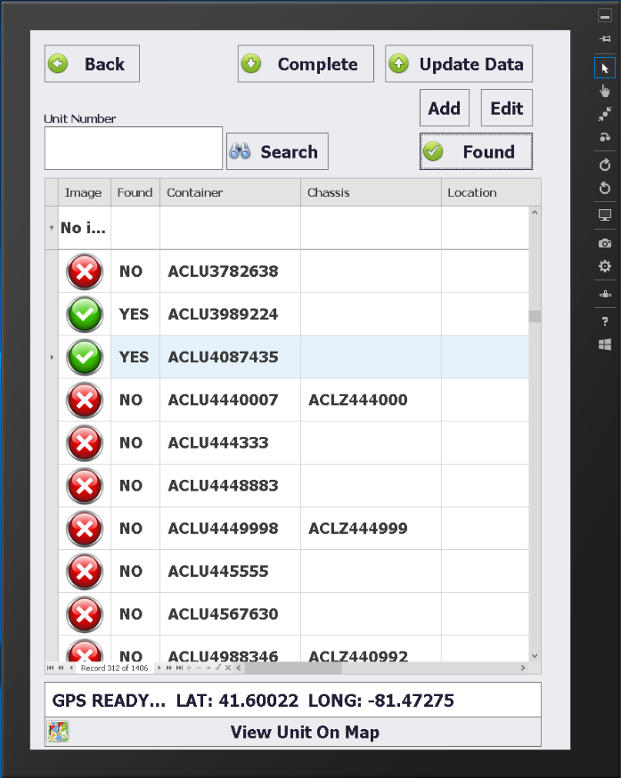
Yard Check
The Yard Check screen can be used to preform inventory checking of all equipment at the depot or terminal.
This screen also allows updating of unit location in the yard via the lot location or optional GPS.

Slide 29
What's Next?
Please see our other PowerPoint presentations for the Windows Tablet Estimate system to support the PC gate system.
Contact Depot Systems to get a full trial system.

Slide 30
depotsystems.com

